Slide 1





Data Analysis Project on Bank Customer Dataset Using Python
Presented by Diaa Ahmed Refat

Slide 2

Data set overview
this Data set is from Kaggle , https://www.kaggle.com/datasets/sakshigoyal7/credit-card-customers .
Last 2 columns that are wrong entry need to remove before start to analysis
it don't have any Null values
it don't have any duplicate values
there is no need for cleaning data as it well collected and cleaned , however you need this data for machine learning model, so you need to do some features engineering
Number of rows is more than 10,000
Number of features is 18

Slide 3
Data set overview
Column | Description | Notes
CUST_ID | Unique customer identifier | Example: C10001, used to distinguish customers
Attrition_Flag | Customer attrition status | Existing vs. Attrited Customer
Gender | Customer gender | Male / Female
Dependent_count | Number of dependents | Number of family members supported
Education_Level | Customer education level | High School, Graduate, Uneducated, etc.
Marital_Status | Customer marital status | Single, Married, Divorced
Income_Category | Customer income category | Less than $40K, $40K-$60K, $80K+, etc.
Card_Category | Type of credit card | Blue, Silver, Gold, Platinum
Months_on_book | Tenure with bank in months | How long the customer has been with the bank
Total_Relationship_Count | Total number of products with bank | Number of relationships/accounts
Months_Inactive_12_mon | Inactive months in last 12 | Months with no activity in the last year
Contacts_Count_12_mon | Contacts in last 12 months | Customer service interactions
Credit_Limit | Credit limit | Maximum amount customer can use
Total_Revolving_Bal | Revolving balance | Unpaid revolving debt
Avg_Open_To_Buy | Average open-to-buy | Credit limit minus used balance
Total_Amt_Chng_Q4_Q1 | Change in transaction amount (Q4 vs Q1) | Seasonal spending variation
Total_Trans_Amt | Total transaction amount | Sum of all transactions
Total_Trans_Ct | Total transaction count | Number of transactions
Total_Ct_Chng_Q4_Q1 | Change in transaction count (Q4 vs Q1) | Growth/decline in activity
Avg_Utilization_Ratio | Average utilization ratio | Used credit / total credit limit

Slide 4
Exploratory Data Analysis

Slide 5
Exploratory Data Analysis
General Demographics Analysis
Account Information Overview
Transaction Behavior and correlation

Slide 6
General Demographics Analysis

Slide 7

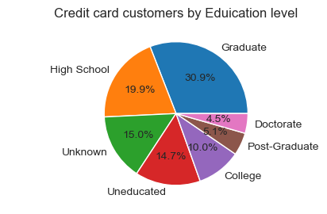
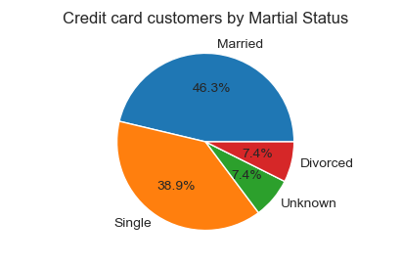

General Demographics Analysis

Slide 8
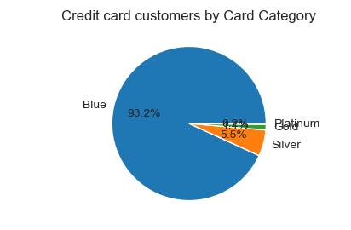
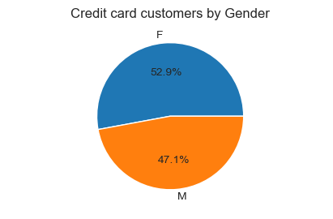
General Demographics Analysis

Slide 9
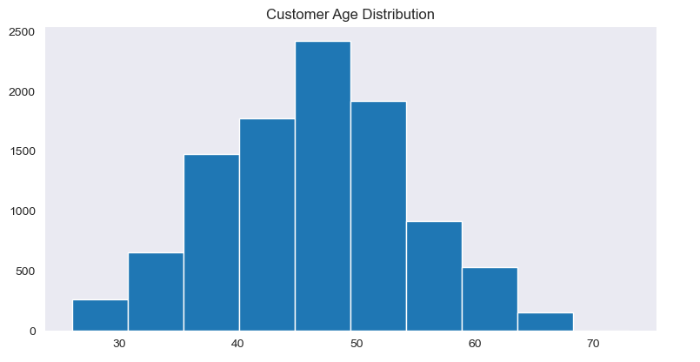
General Demographics Analysis

Slide 10
Account Information Overview

Slide 11
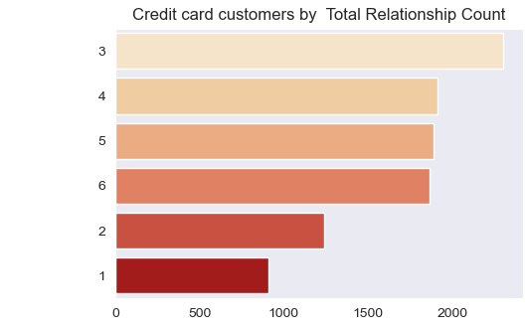
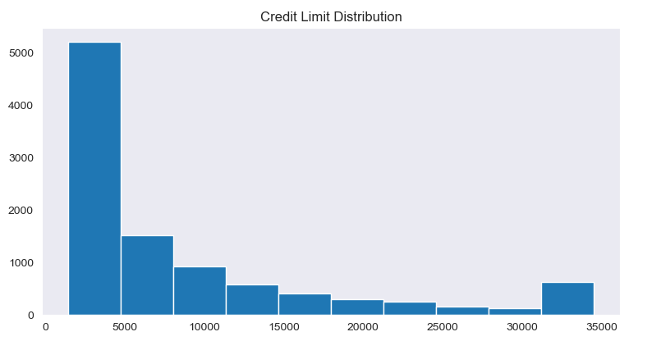
Account Information Overview

Slide 12
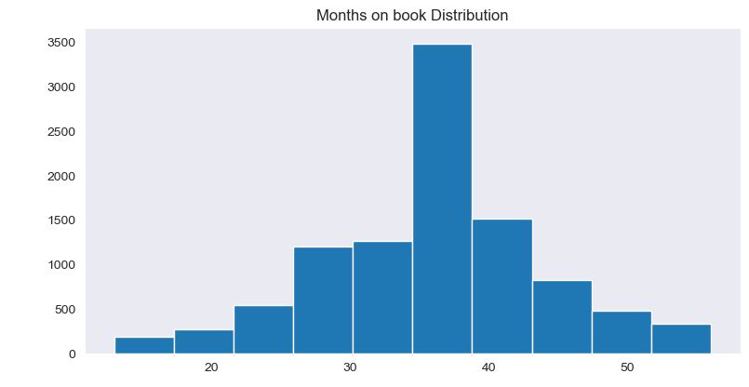
Account Information Overview

Slide 13
Transaction Behavior and correlation

Slide 14
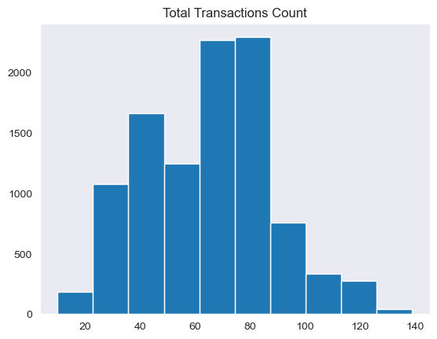
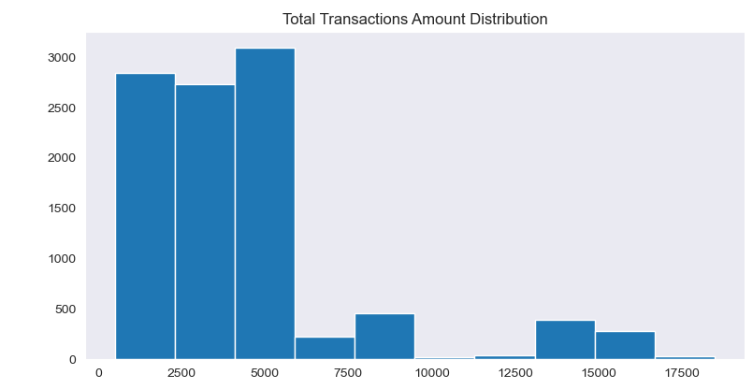
Transaction Behavior

Slide 15
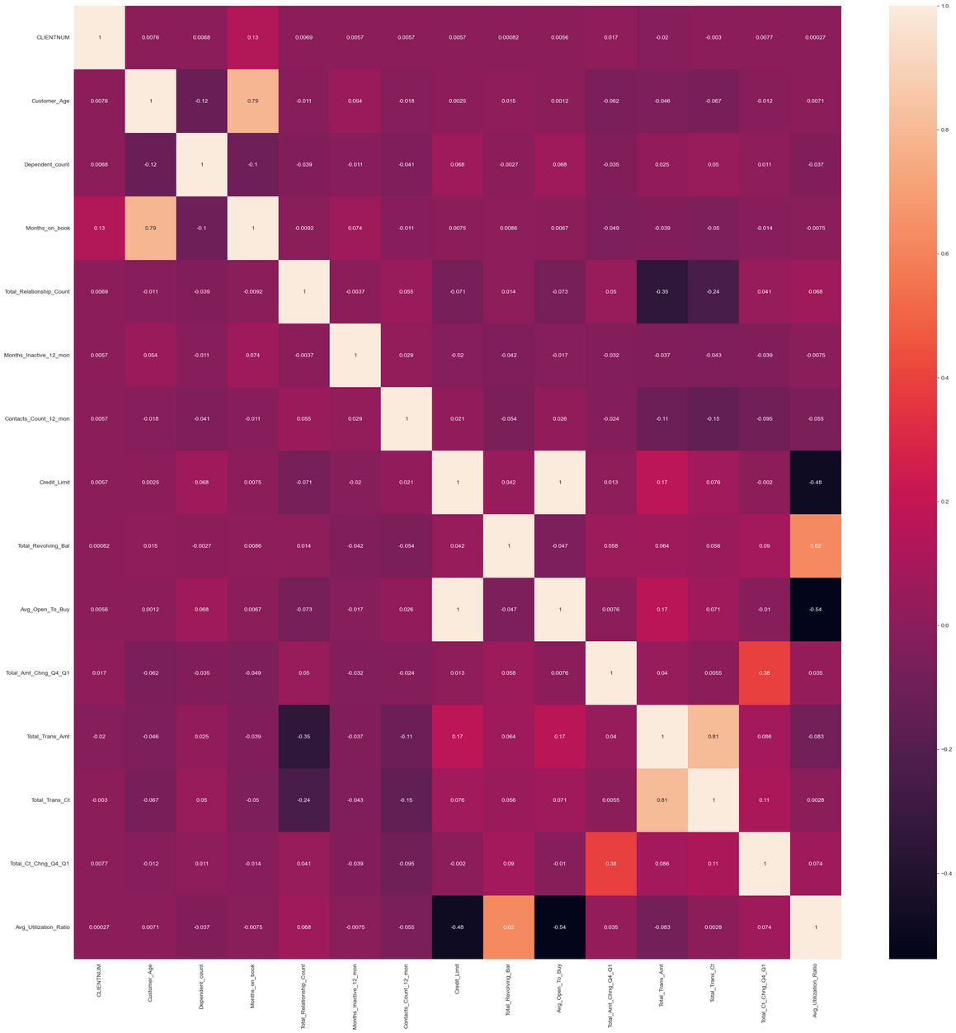
Correlation Heatmap

Slide 16
business questions and insights

Slide 17

What is our target
As banking industry, we want now to know what is our churn rate and what is the causes of this rate ,
Simply the answer is !!
Attrition Flag

Slide 18
❓ Business Questions to Answer (via EDA)
Does gender affect attrition?
Are married customers more likely to attrite?
Which education levels have the highest attrition?
How does income category impact attrition?
Is there a relationship between number of customer service calls and attrition?
What is the typical transaction count for attrited customers?
Do inactive months contribute to attrition?
Does credit limit influence attrition?
How does the average transaction amount differ for attrited customers?
What is the effect of utilization rate on attrition?
Which age group is most likely to attrite?

Slide 19
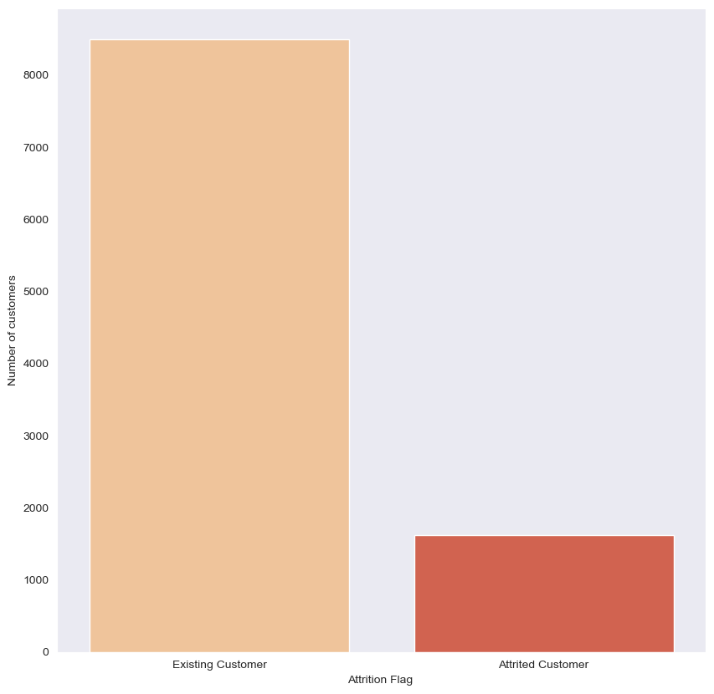
Focus on Attrition

Slide 20
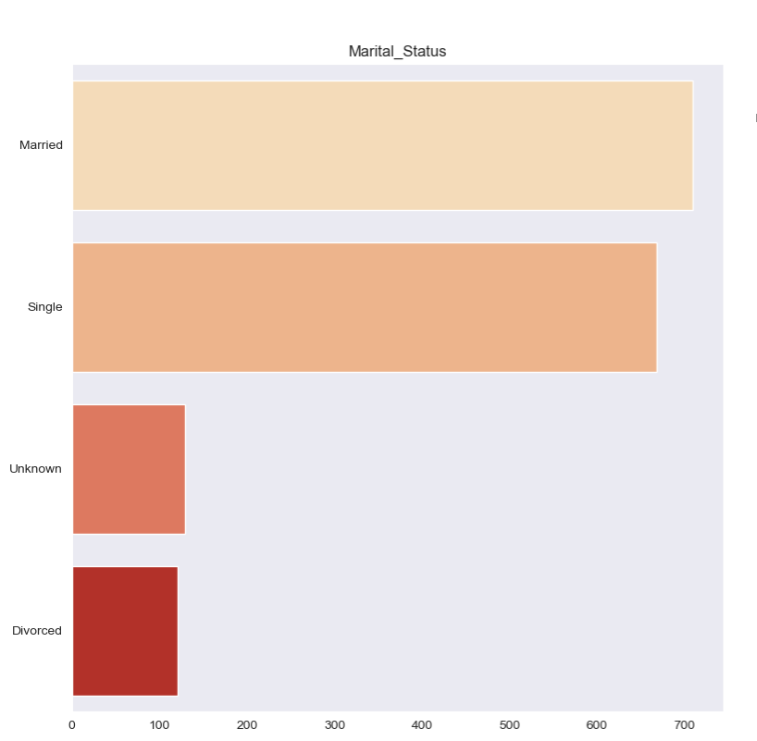
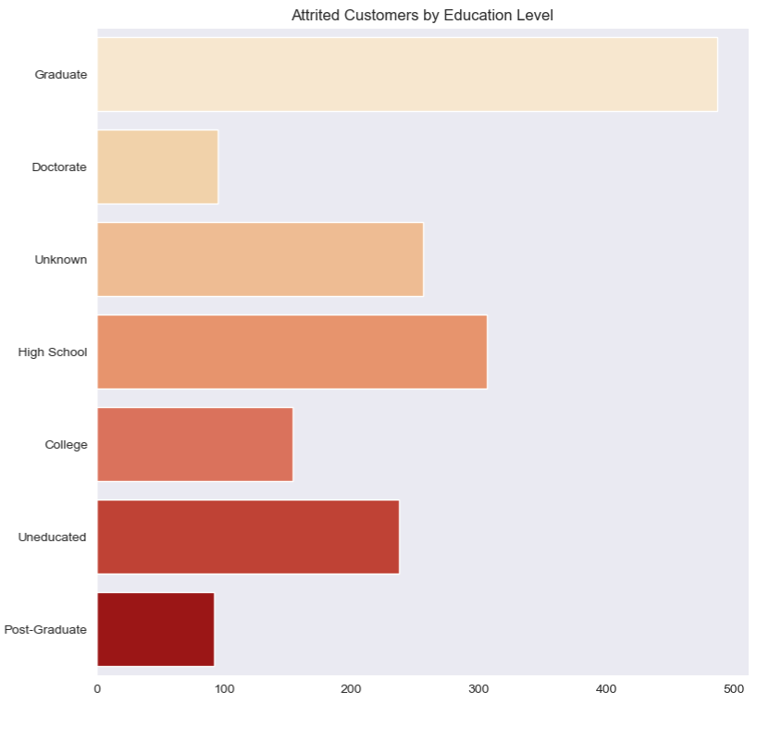
Focus on Attrition

Slide 21
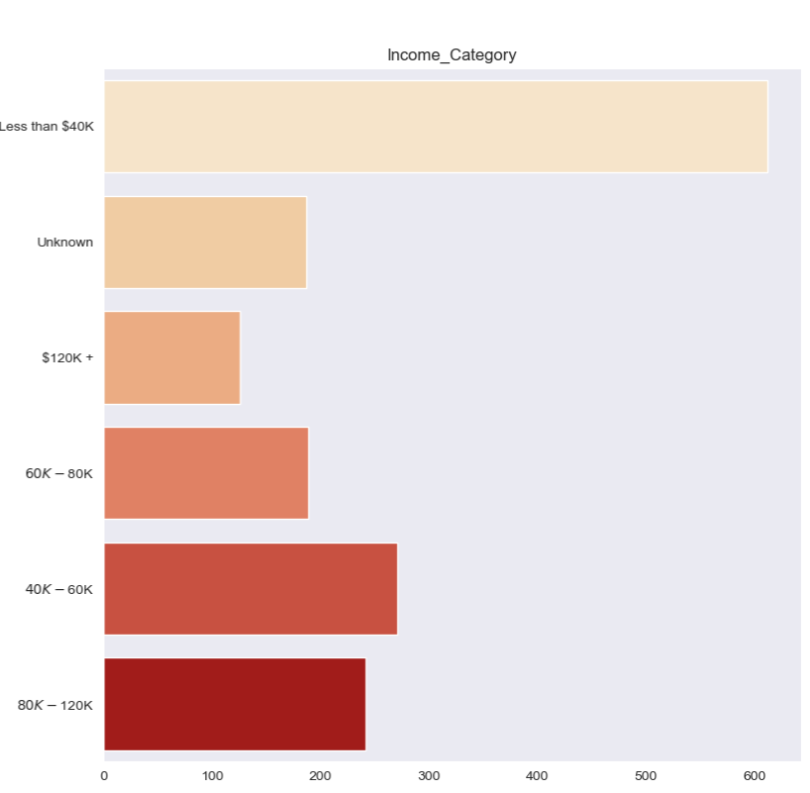
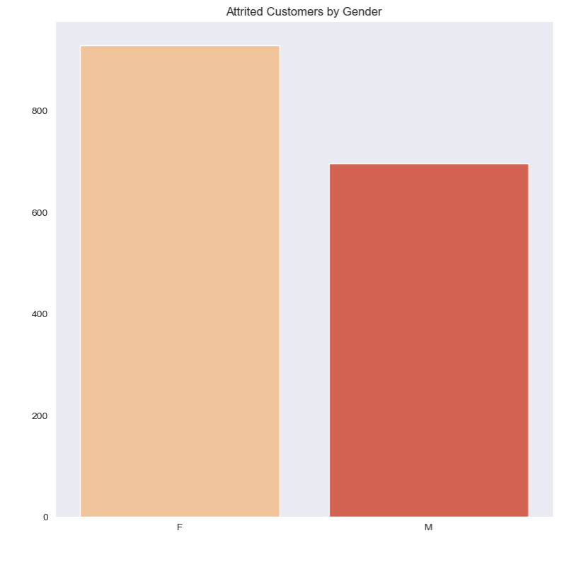
Focus on Attrition

Slide 22
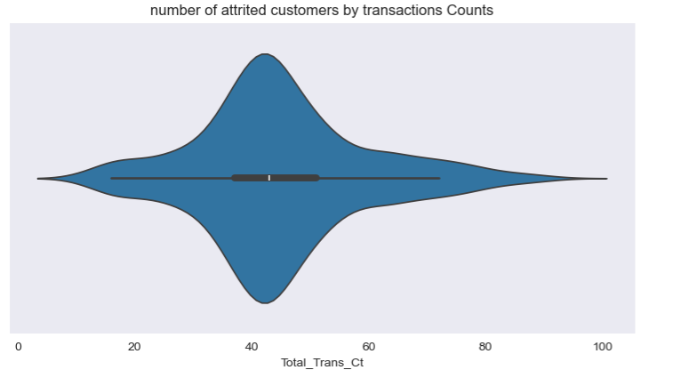
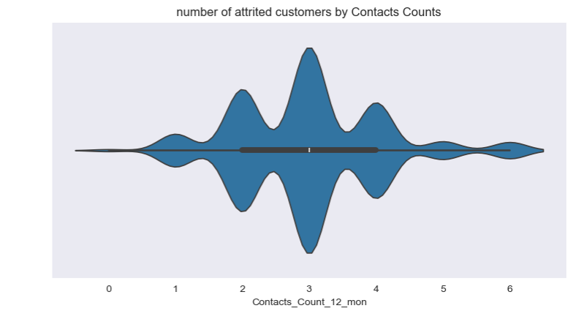
Focus on Attrition

Slide 23
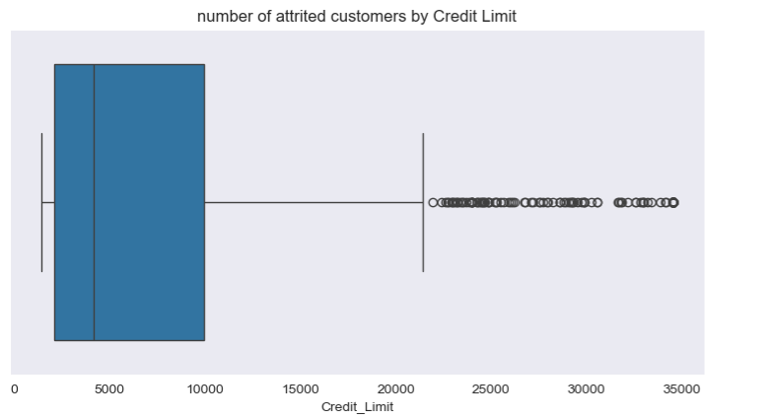
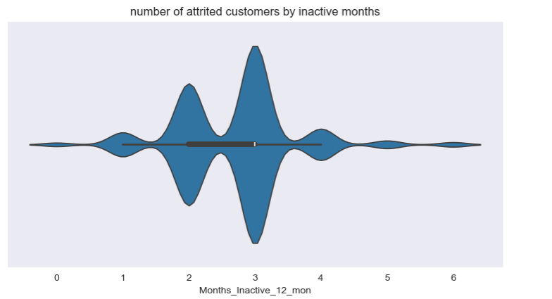
Focus on Attrition

Slide 24
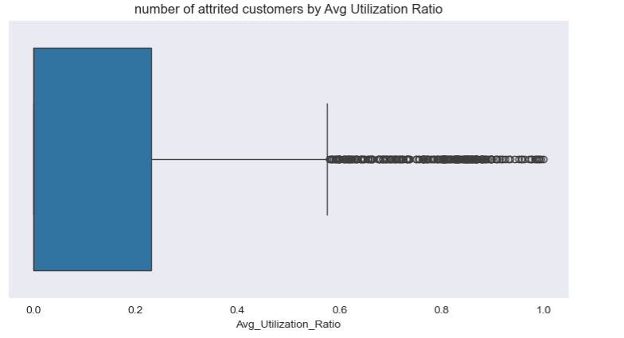
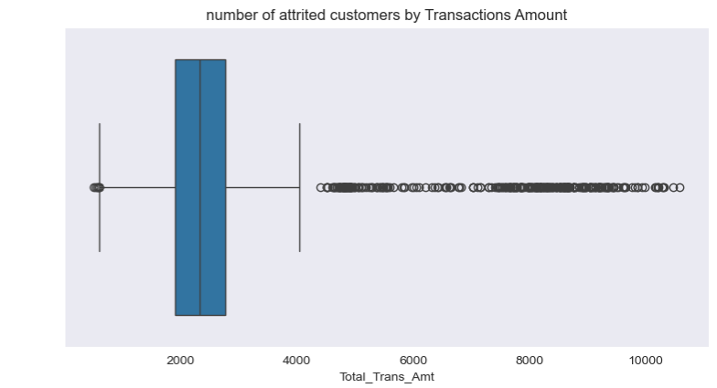
Focus on Attrition

Slide 25
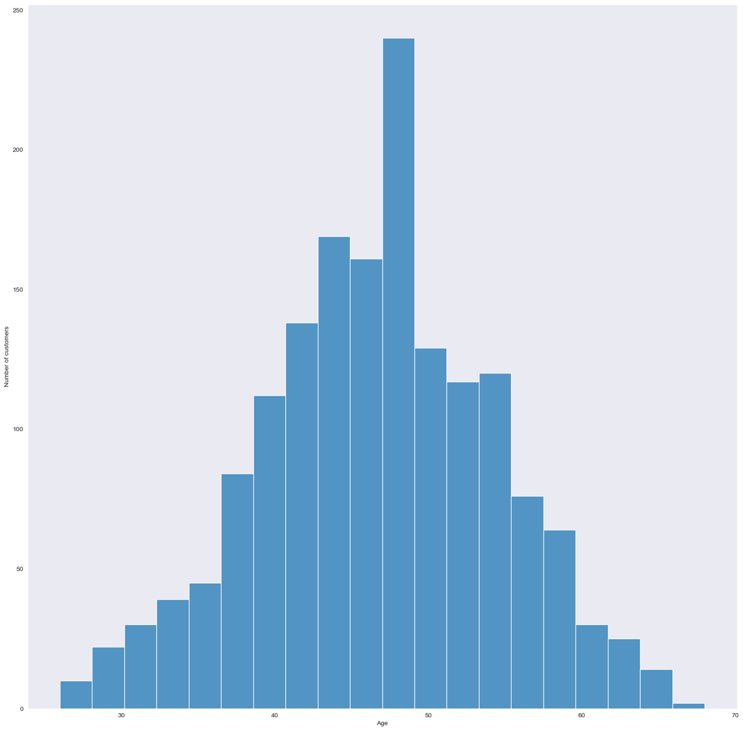
Focus on Attrition

Slide 26
Key Findings from EDA (Attrition Analysis)
Gender: Female customers appear more likely to attrite compared to males.
Marital Status: Married people show slightly higher attrition rates than singles.
Education: Graduated customers are more prone to attrition than other education categories.
Income: Extremely high attrition is observed among low-income customers.
Customer Service Calls: Attrited customers often contacted the bank 2–5 times before leaving.
Transaction Count: Attrited customers usually perform 20–60 transactions.
Inactive Months: Attrited customers typically have around 3 inactive months.
Credit Limit: They tend to have lower credit limits.
Transaction Amount: Attrited customers show average transaction amounts, not very high.
Utilization Rate: Attrited customers usually have a low utilization rate.
Age: Customers aged 40–60 years have higher attrition rates.

Slide 27
Key Findings from EDA (Attrition Analysis)
💡 Recommendations
Targeted Retention Campaigns: Focus on married and middle-aged (40–60) customers with low income.
Customer Engagement: Improve loyalty programs and personalized offers for customers with medium transaction activity (20–60).
Proactive Support: When a customer calls more than twice, flag them for special follow-up to prevent attrition.
Credit Limit Review: Reconsider credit limit policies for at-risk customers with low utilization.
Financial Education: Provide tailored communication to graduates and low-income segments about maximizing card benefits.

Slide 28
Conclusion
Our analysis of the bank customers dataset revealed clear patterns behind customer attrition.
Attrited customers are often middle-aged, married, and graduates, with relatively low income, low credit limits, and low utilization rates. They usually show medium transaction activity (20–60 transactions), experience around 3 inactive months, and contact customer service more frequently before leaving.
These findings highlight that attrition is not random — it is strongly connected to customer demographics, financial capacity, and engagement behavior.
By addressing these risk factors through proactive customer support, personalized offers, and loyalty programs, the bank can significantly reduce churn and improve long-term customer retention.

Slide 29
Thank You

